Slide 1
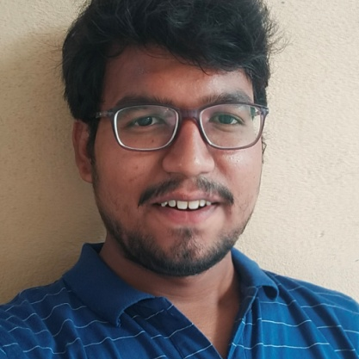


Madduru Vijay Kumar Reddy
Analyst/Software Engineer
Bachelor of Technology
Computer science & Eng. :2017-2021
Skills
Java 8 /J2EE
Spring Boot
Spring MVC
JPA CRUD
Bootstrap
React
Database
SQL database – MySQL
Web Technologies
HTML5
CSS3
JavaScript
Certification
Completed Dot Net developer certification
Completed Agile Fundamentals certification
Additional Details
Leadership
Excellent Communication Skills
Team management
Quick Learner
Hyderabad
Madduru-vijay.reddy@capgemini.com
+91 9494102037
A4
Proficient in JAVA and OOPs concepts.
Hands on experience in creating Web Application with Spring boot , Java, Rest API, React.
Hands on experience in developing web pages using HTML5, CSS3, Object Oriented Programming, JSON, XML. Good understanding of Document Object Model (DOM) and DOM Functions.
Proficient in creating Web Application in React with Authentication with routing.
Experience in creating documentation with swagger and unit testing using JUnit and Mockito.
Movie Ticket Booking Application
Completed end to end case study of Movie ticket booking application System . along with API Gateway, Swagger,Postman, responsive UI with HTML5, CSS, Bootstrap and React used as User Interface.
HTML, CSS, JAVASCRIPT for web developers at Coursera
Completed this course with 91.6% and Designed responsive Restaurant website using HTML5 CSS3 Bootstrap and JavaScript.
Azure
Completed Microsoft Azure Fundamentals-AZ900 certification
.

